Slide 1
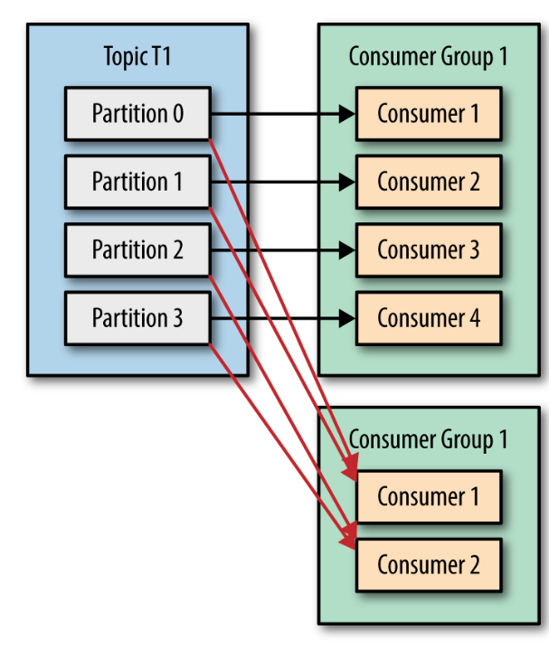
Kafka Topics, Partitions, and Consumers
A consumer group can only scale to the number of partitions

Slide 2
